Slide 1

BIG DATA
Sandeep Kumar Bhandoria
sandeepkbh47@gmail.com
NIIT, Janakpuri, Delhi

Slide 2
Outline
Introduction
What is Big Data?
4v’s And Type of “BIGDATA”
When Big-Data is really a problem?
Prerequisites
Hadoop
Daily Achievement
Technology Used
Concepts
GITHUB

Slide 3
What is BIG DATA
BIG DATA is extreme volume of data both structured, semi structured and unstructured data .
BIG DATA is often characterized by 4v’s volume, variety, veracity, velocity.

Slide 4
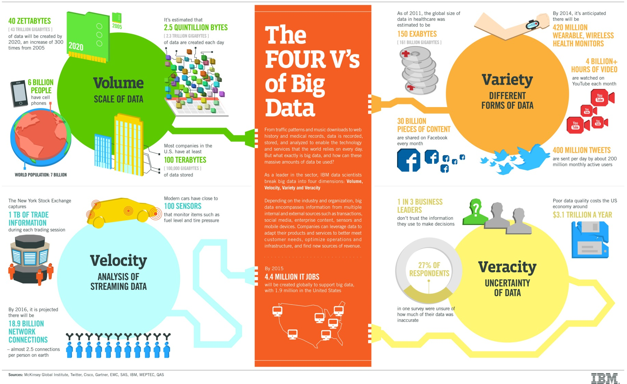
4v’s of BIG DATA

Slide 5
4v’s of BIG DATA
Volume-Defines the extreme amount of data.
Velocity- Defines the data that keeps on changing.
Veracity-Accuracy of data
Variety-Different forms of data such as Structured and semi-structured and unstructured.

Slide 6
Type of Data is BIG DATA
SOCIAL NETWORKING DATA
GPS LOCATION DATA
SHOPPING HABBITS
SERACH PATTERNS
ONLINE INTERESTS

Slide 7
PROBLEMS ASSOCIATED WITH BIG DATA
PHYSICAL PROBLEMS
PROCESSING PROBLEMS
INCORRECT DATA
LARGE AMOUNT OF COST SPENT BY SMALL BUSINESS

Slide 8
Industries that benefits from BIG data Analysis
Retail Industry
Product creation, supply chain planning
Healthcare
Guide physicians which treatment offers best outcome
Insurance
By analyzing customers records to provide diverse and better insurance services
Telecommunications
Provide better plan like data plan ,message plan
Oil and Gas
Example Shell is the number one global lubricant supplier.
Engine oils
Lubricants for cars, motorcycles, trucks
Shell is able to more efficiently assess ideal locations for drilling.

Slide 9
Pre-Requisite for Big DATA
Java Essential
OOPs Concept
Conditional constructs such as If Else Switch
Access specifier- private, protected, default and public.
Functions
Constructors
Exception Handling

Slide 10
Pre-Requisite for Big DATA continued…
Collections –Maps, Sets and List
Generics
SQL Queries
Create table
Insert into table
Update a table(rows)
Delete a row
File Handling
J2EE- Servlet, JSP, HTML

Slide 11
Hadoop
Hadoop is an Apache open source, Java-based programming framework that supports the processing and storage of extremely large data sets in a distributed computing environment.
Hadoop 1.x and 2.x architecture

Slide 12
VM Box and Hadoop Installation
Installation of virtual box.
Installation of Putty and Winscp.
Importing Image in VM
RAM, Network, Intel-Virtualization check and some basic troubleshooting.
Basic Linux Commands
Installing Hadoop 2.7.1
Starting, Stopping and verifying Hadoop services.

Slide 13
Hadoop Ecosystem components we learnt
Apache HDFS
Apache MapReduce
Apache HIVE
Apache PIG
Apache SQOOP
Others
Oracle MySQL database

Slide 14
Apache HDFS and Map Reduce
Apache HDFS (Hadoop Distributed File System) is a distributed file system designed to run on commodity hardware.
Hadoop MapReduce is a software framework for easily writing applications which process vast amounts of data. It enables parallel processing on large clusters (thousands of nodes) of commodity hardware in a reliable, fault-tolerant manner.

Slide 15
Apache HIVE and PIG
Apache HIVE is a data warehouse built on top of Hadoop for reading, writing, and managing large datasets residing in HDFS using SQL (HIVEQL).
Pig is a scripting language for creating program that run on top of Apache Hadoop.

Slide 16
Apache SQOOP and ORACLE MySQL
Apache SQOOP is a tool designed for importing and exporting data from and to a RDBMS databases.
MySQL, is a Open Source SQL database management system, is developed, distributed, and supported by Oracle Corporation.

Slide 17
Concepts we learnt
Simple Map Reduce Java Project
Mapper
Combiner
Partitioner
Reducer
Advance Map Reduce Java Project
Simple Map Reduce app plus
Custom InputFormat
RecordReader
Map-Side Join
Reducer-Side Join

Slide 18
Concepts we learnt
HIVE
Create table
Load data
Export data
PIG
LOAD data
FILTER data
GROUP data
JOIN data
DUMP AND STORE data
MySQL
SQOOP
Import data from RDBMS
Export data to RDBMS

Slide 19
Project 1 E-Commerce Online Transaction Analysis
BACKGROUND - I am a Hadoop Developer.
OBJECTIVE – Project is based on real time analysis of a online transaction data given by one of our client company. This Ecommerce project gathers some facts like
how much monthly revenue company is generating?
What is his top selling products?
Who are the Top customers?
Profession who is most affected by their Products?

Slide 20
Project 1 E-Commerce Online Transaction Analysis
TECHNOLOGY USED-
Apache Hadoop
Map Reduce Programming
HIVE
PIG
SOFTWARE USED-
Virtual Box
Eclipse
Ubuntu

Slide 21
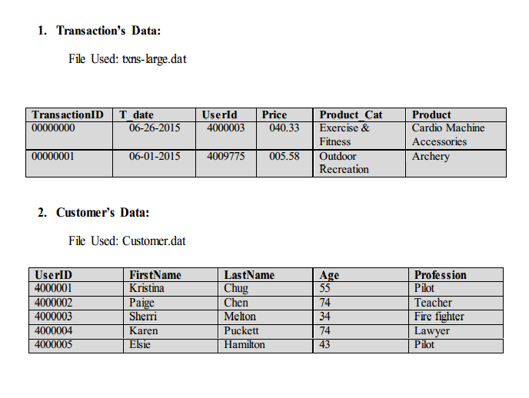
Data we have for Project 1

Slide 22
Some Use Case from Project 1
Use CASE1
Heavy Price based Transaction.
User has to specify a minimum price here.
Validation of input is done here so that task only runs when we got valid input in number.
Task done in HIVE, PIG and MAP REDUCE.

Slide 23
Use CASE2 :Price range based products
User has to specify a minimum and maximum price.
Validation of input is done here
Maximum price can’t be less than the minimum price.
Minimum and maximum can’t less than zero.
User will displayed message for the above if he/she
violate these constraints.
Task done in HIVE, PIG and MAP REDUCE.

Slide 24
Use CASE3: Customer Wise Transaction and Purchase
Its display the past number of transaction a user had.
Total amount they spent.
Here we can get the information about the customer interest in our products.
Data here can also we used to provides more benefits to those to spent more than some certain amount.
Task done in HIVE, PIG and MAP REDUCE.

Slide 25
Use CASE4: Monthly Revenue
This give insight of how much revenue a company is generating.
We are taking input from the user here for month.
Validation of input is done here for months between range of 1 to 12.
User can also input Three-abbreviated form for months in any case like JAN, feb etc.
Task done in HIVE, PIG and MAP REDUCE.

Slide 26
Use CASE5: Monthly Wise Transaction Summary
This will gives you monthly wise transaction data and then you can analyze the individual files.
Task done in HIVE, PIG and MAP REDUCE.

Slide 27
Use CASE6: Targeting Top Profession for new products
This help in analyzing the customers who are more interested in our products and for them they want to bring something extra.
Task done in HIVE, PIG and MAP REDUCE.

Slide 28
Use CASE7: Analyzing the top 3 Customers Use CASE8: Analyzing the top Customer per month
In both of the use case the company want to give rewards to the customer. There can be top 3 customers and they can give rewards on the basis of the month.
Task done in HIVE, PIG and MAP REDUCE.

Slide 29
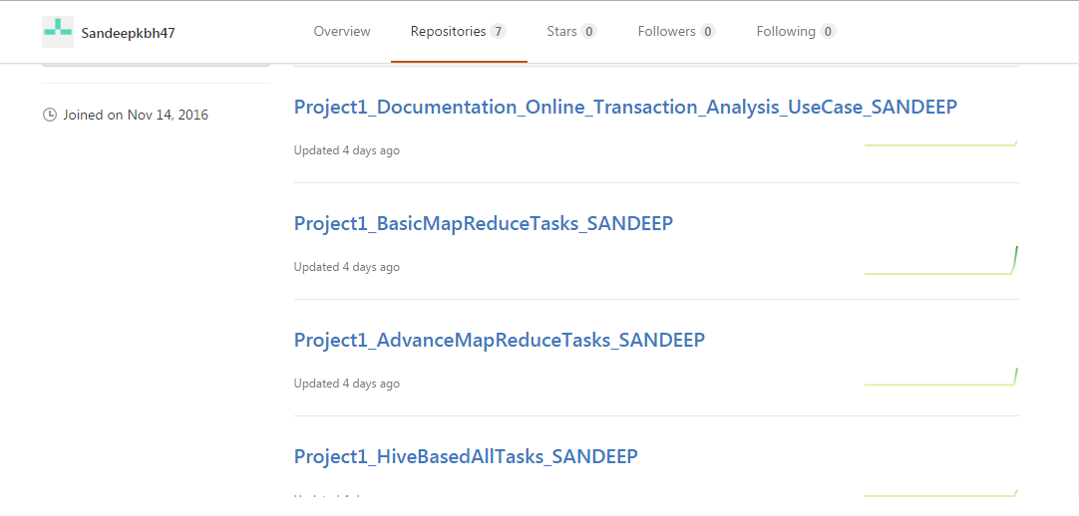
GITHUB Maintenance https://github.com/Sandeepkbh47

Slide 30
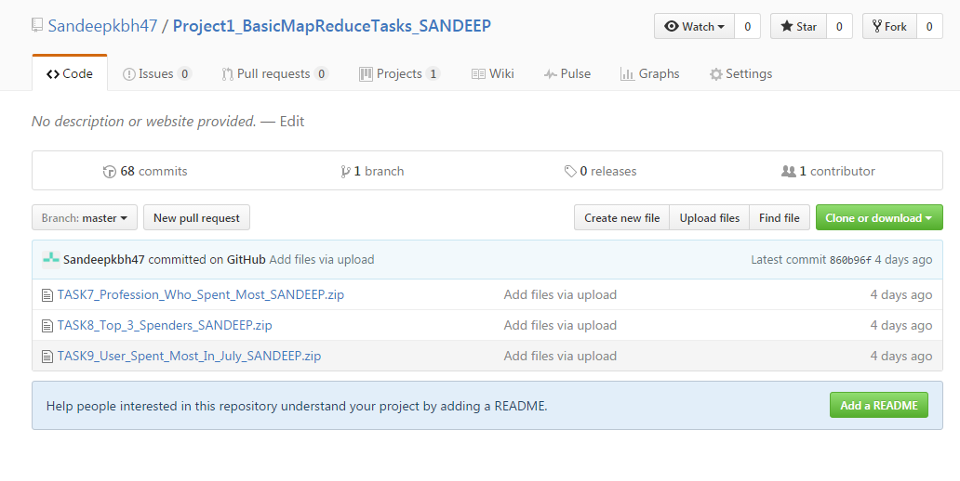
GITHUB Maintenance

Slide 31
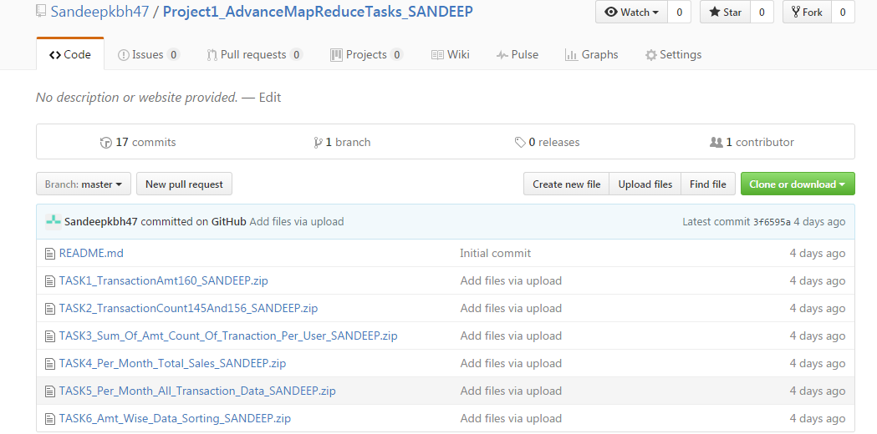
GITHUB Maintenance

Slide 32
PROJECT 2 GLOBAL EMPLOYABILITY & EDUCATIONAL ANALYSIS
OBJECTIVE
The main objective of this project was to come up with relevant information for
New IT Sector companies,
New Matrimonial Sites,
Global Education Status ,
Ratio of native born and immigrants people,
New Policies for Widow and Divorce and Senior Citizen
Creating Election Port-Folio

Slide 33
PROJECT 2 GLOBAL EMPLOYABILITY & EDUCATIONAL ANALYSIS
TECHNOLOGY USED
Apache Hadoop HDFS
Apache Hadoop Map Reduce
Apache HIVE
Apache SQOOP
Apache PIG

Slide 34
PROJECT 2 GLOBAL EMPLOYABILITY & EDUCATIONAL ANALYSIS
SOFTWARE USED
Virtual Box
Eclipse
Ubuntu
Cloudera

Slide 35
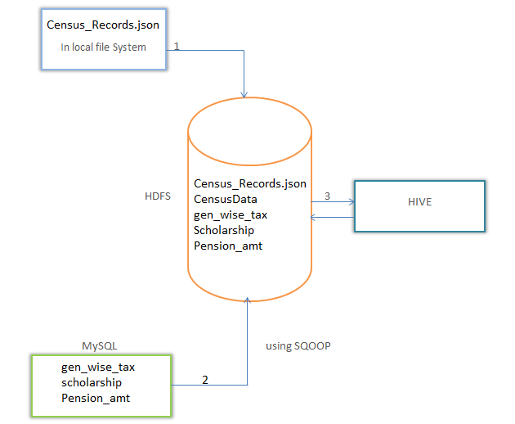
Data We Used

Slide 36
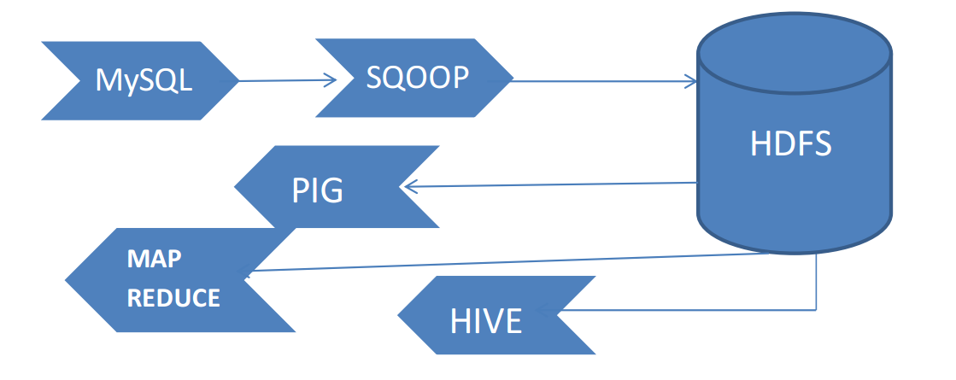
Flow of Information in Census project

Slide 37
USE CASE 1 : Comparative Literacy Statistics on country.
Literacy rate for India in 2011 is 74% as compared to other neighbouring country Myanmar, Sri Lanka and China. The main factors for low literacy rate are lack of education and availability of school in vicinity in rural areas.
But within last 4 year India has indicated rising literacy in most of their states which make the literacy rate 90% in 2015.
A recent change in the government has done so much help in rural sectors. And a recent analysis is required to calculate the male female educated count for 2016.
TASK1 done in both HIVE and Simple Map Reduce.

Slide 38
USE CASE 2 : Literacy and Level of Education
Even after the literacy, it’s important to know at what level of education people are at.
A survey is required to know
Which stream in graduation helps people get a job?
How many students are already employed when they are in college?
How 10 & 12 Grade students are working to earn money.
TASK 2 in HIVE

Slide 39
USE CASE 3 : Need of Educational Institute
With the changing meaning of educational institutions – to institutes for learning to dynamic educational and cultural centres of the society, running a school or college has become a challenge in itself. Aside from the infrastructure facilities and quality value-based education, a number of people where to build a new institute are also important.
Location and education of the people around the new institute is an important factor to analyse first.
So here an Education wise analysis is done to get a clear picture of the level to education people have.
Done in HIVE and Advance Map Reduce

Slide 40
USE CASE 3 : Need of Educational Institute
Done in HIVE and Advance Map Reduce
User Input: User must enter an age
Custom Input Format Key: Education
Custom Input Format Value: Age
Output: Text and IntWritable
Others: Mapper, Reducer
Validation are done on age
User can’t pass a string when asked to enter age limit, so it must be a number.
Maximum age must be greater than the minimum age.
In case of violation of the first rule an Error Message is displayed to enter a valid age in number.

Slide 41
USE CASE 4 States Wise PCI (Per Capita Income) Comparison
The PCI per person with respect to States differ a lot even while we have industry salary standards. People in Bangalore might have high salary as compare to the one in Delhi.
So states wise PCI can be done to get the overall development of financial status of a person.
Gender Wise Per Capita Income (PCI)
Education and Gender Wise Per Capita Income (PCI)
Done in HIVE

Slide 42
USE CASE 5 Feasibility of new pension policy for senior citizen
TASK6 Total amount dispensed on pension in x years(s)
TECHNOLOGY USED: 1) MySQL 2) SQOOP 3) HIVE
Done in HIVE Using SQOOP and Advance Map Reduce.
Validation:
1. User can’t pass a string when asked to enter a year, so it must be a number. 2. Year in number are checked for its length. They must have 5 digits. 3. In case of violation of the above rule an Error Message is displayed to enter a valid year.

Slide 43
USE CASE 5 Scholarship to unmarried daughter of Divorced or Widow female
TASK 7: Amount dispensed on scholarship
TECHNOLOGY USED: 1. PIG 2. MySQL 3. SQOOP
TASK 8: Employable Female widowed and divorced
TECHNOLOGY & SOFTWARE USED: 1) MapReduce In JAVA 2) Eclipse
Custom Input Format Key: Age Custom Input Format Value: Marital Status and gender

Slide 44
USE CASE 6 Election Port-folio
A new political party is planning to come in for the election. And to stand ground in the election against the parties we have in India. They want to analyse the number of voters they can target this current and in the next coming year.
They have to come up with best portfolio for election and for this they need to know the number of voter, senior citizen they have in their local area, city and country.
Plus the Total number of male and female voters are there?
Ratio of native born and foreign people?

Slide 45
USE CASE 7 Education for RURAL development
Rural development is possible if we are able to bring to them the
Access to proper education (Primary, secondary and higher)
Training and support
Employment
TASK 13 Degree Wise count for employability
Done using HIVE and PIG.

Slide 46
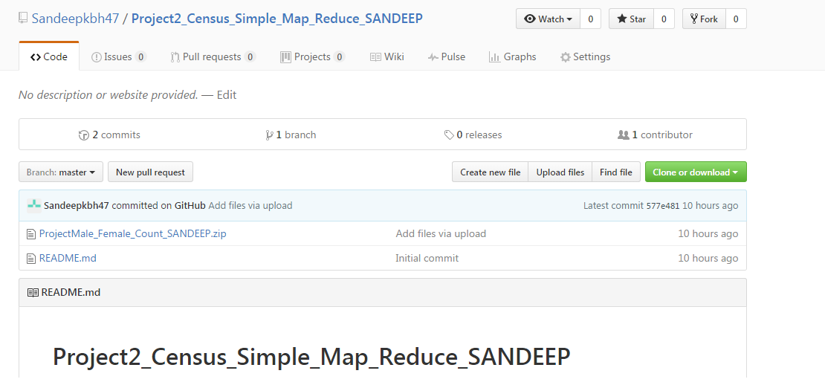
GITHUB Maintenance Project 2

Slide 47
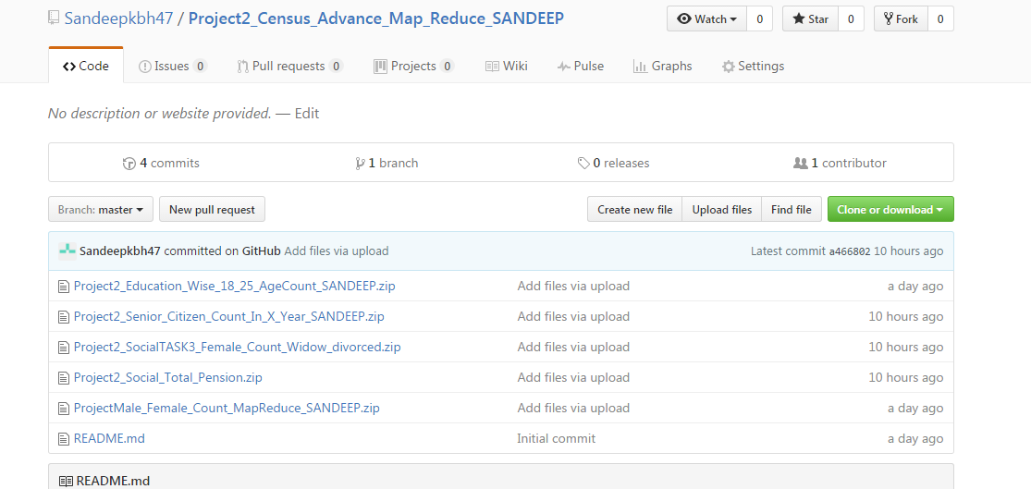
GITHUB Maintenance Project 2

Slide 48
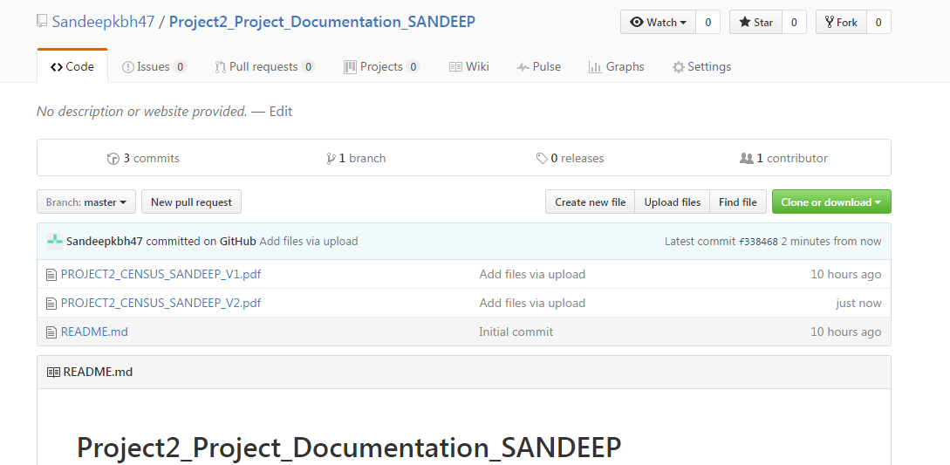
GITHUB Maintenance Project 2

Slide 49
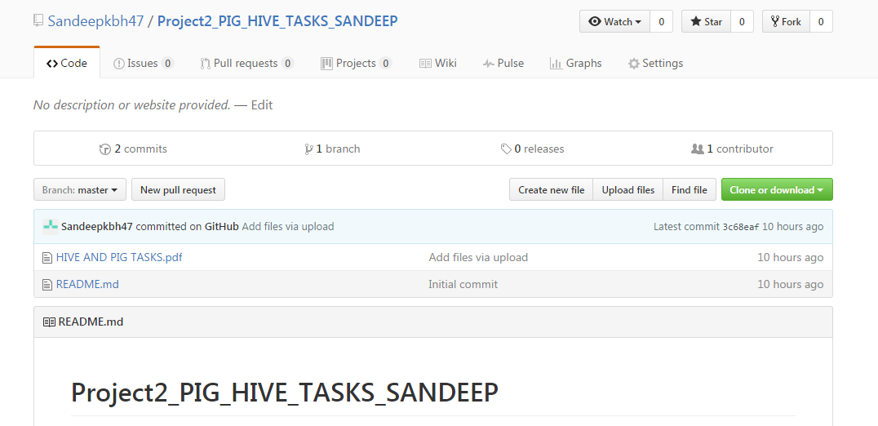
GITHUB Maintenance Project 2

Slide 50
THANK YOU

